Slide 1

Full Stack Project II
SHOP
HelloTech
GLA University
Mathura-281406 , India
Submitted By:
Mukund Agrawal(B/181500401)
Mukul Agrawal (A/181500397)
Krishna Gupta (A/181500330)
Vishal Singh (D/181500809)
Under THE
SUPERVISION OF:
MR. Pankaj Kapoor

Slide 2
Problem Statement
Retail revenue from consumer electronics/technology sales in the U.S. is projected to top $350 billion in 2018.
If you’re like most businesses in this fast-growing and highly competitive market segment, you’re looking for an edge to capture the largest possible share of this revenue. That edge is ecommerce excellence.
If you expect to grow your business this year, you need to give customers an exceptional online shopping experience.

Slide 3
Objective
PAY
01
Attracting and retaining customers
02
Web design, usability and natural positioning
03
Comprehensive product information
04
Peace of mind for customers

Slide 4
Languages and Frameworks
MERN Stack
MongoDB
Express
ReactJs
Node.Js
For Media Query and website responsiveness we have used CSS 3.

Slide 5
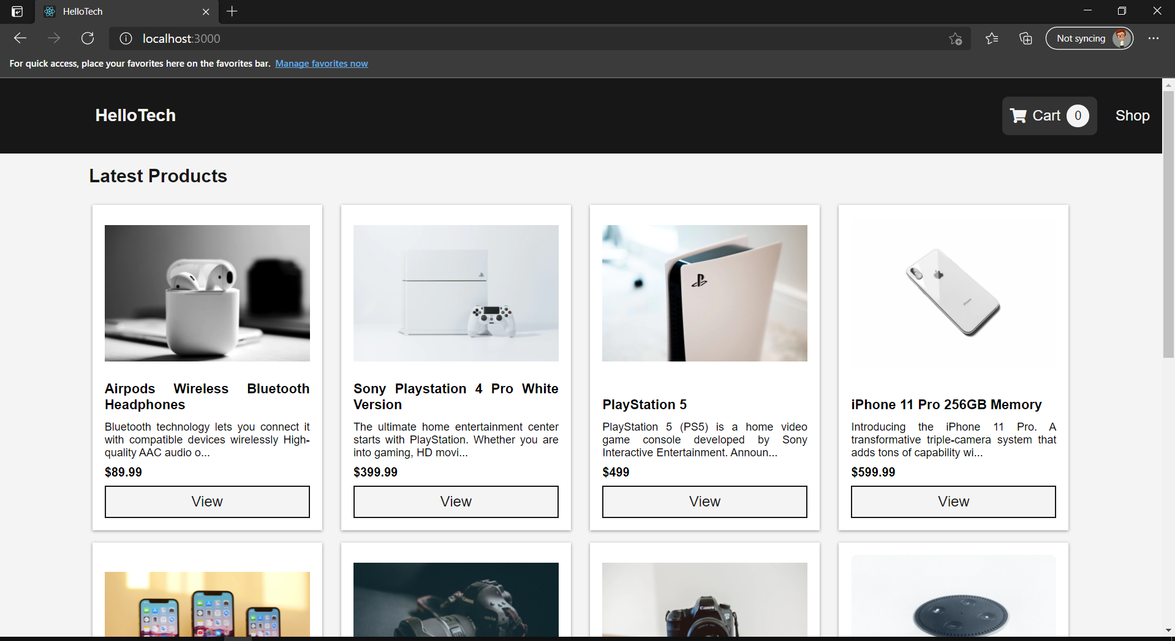
Screenshot

Slide 6
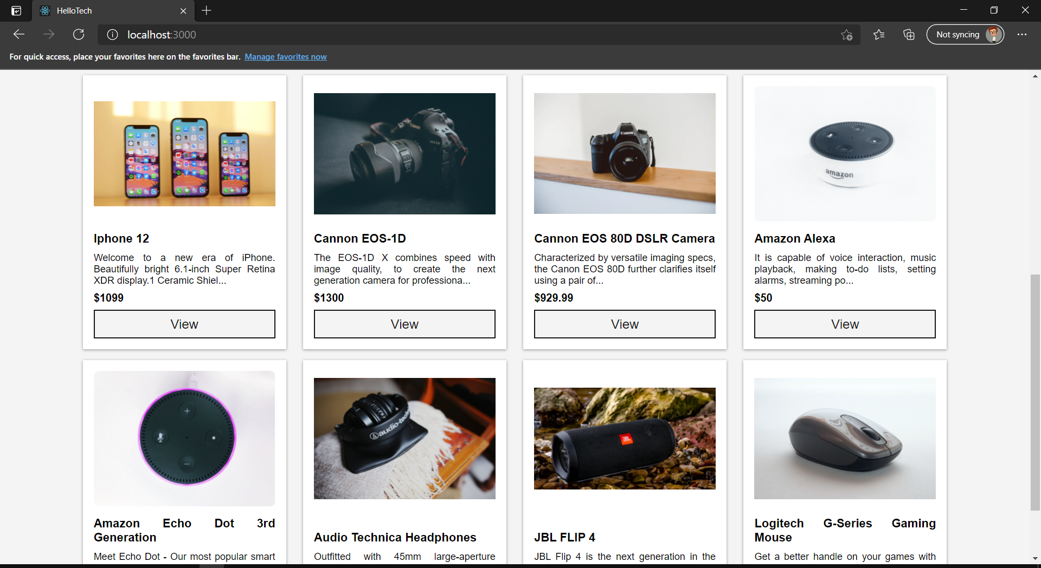
Screenshot

Slide 7
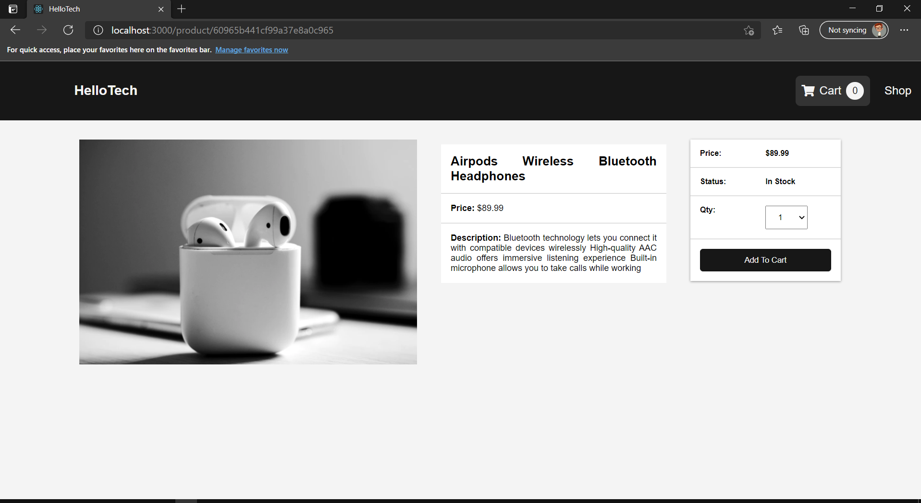
Screenshot

Slide 8
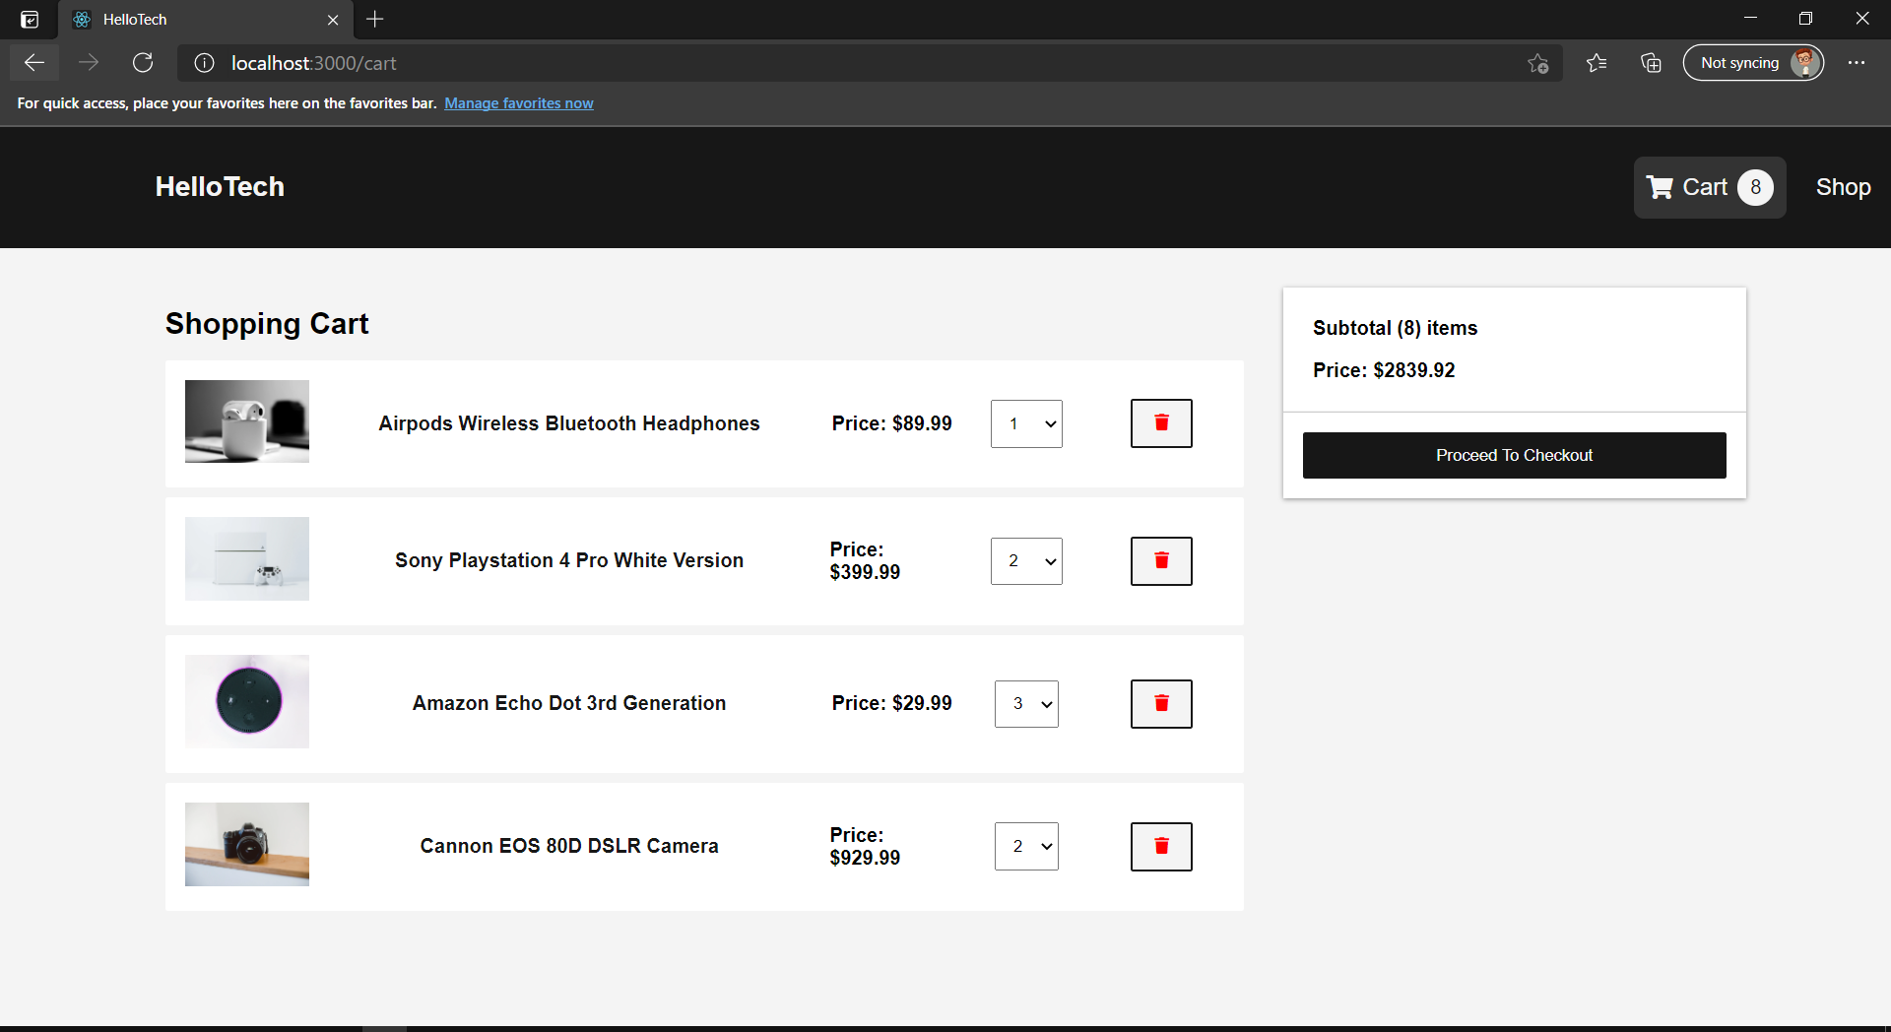
Screenshot

Slide 9
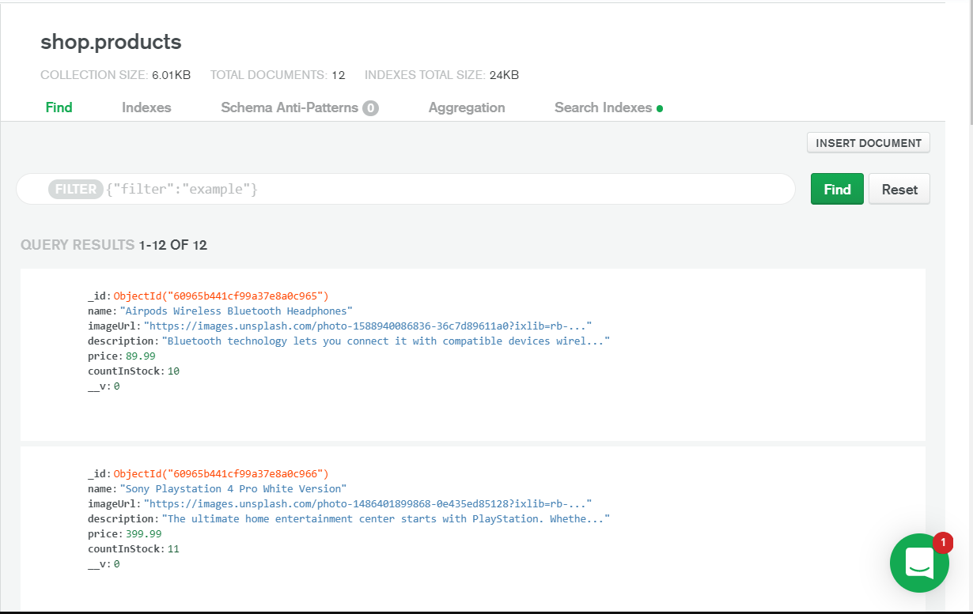
Screenshot

Slide 10
Thank You

